Slide 1

The Right Priority
Collection Closure
Chris Piech
CS 106B
Lecture 5
Jan 15, 2016

Slide 2
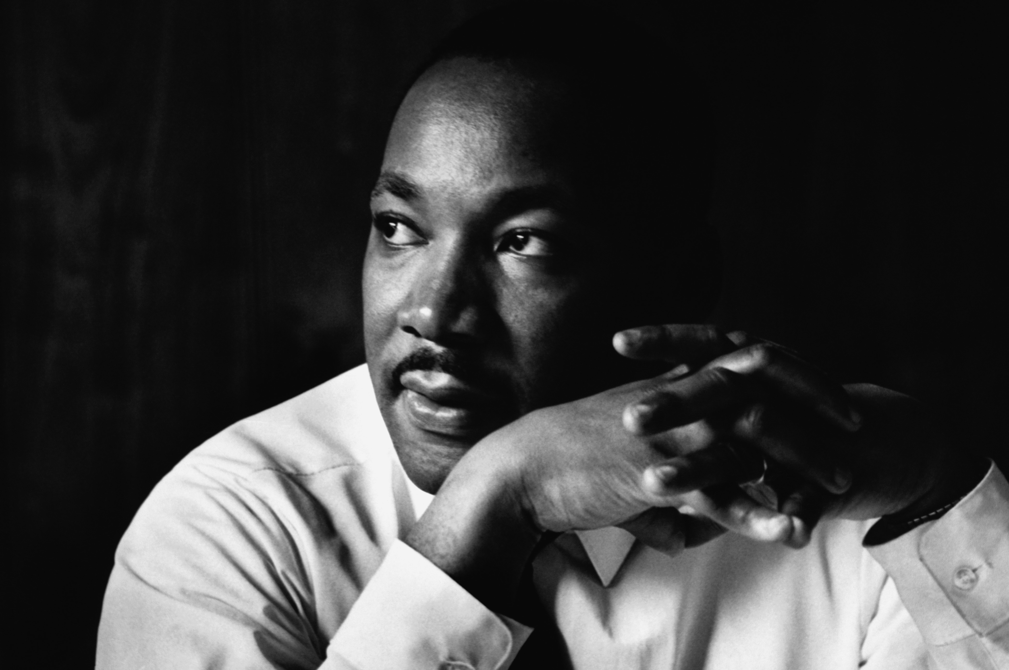
No Class Monday

Slide 3
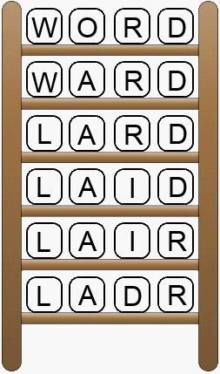
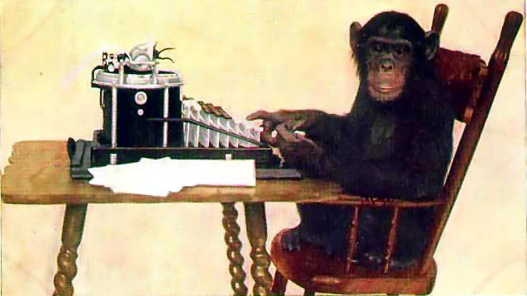
Assignment 2 Serafini
Two great ideas from Computer Science

Slide 4
Assignment 2 Serafini
Two great ideas from Computer Science
Y.E.A.H. Hours
Tue, Jan 19th 5-6pm
Braun Auditorium
Will post slides

Slide 5

CS106B Contest

Slide 6
Prizes

Slide 7
[suspense]

Slide 8
100% on the Final

Slide 9

CS106B Contest
Two categories
Algorithmic Complexity
Creativity

Slide 10
CS106B Contest
Rules…
http://web.stanford.edu/class/cs106b/assn/contest.html

Slide 11

Socrative.com
Room: ACRFU4PQ3

Slide 12
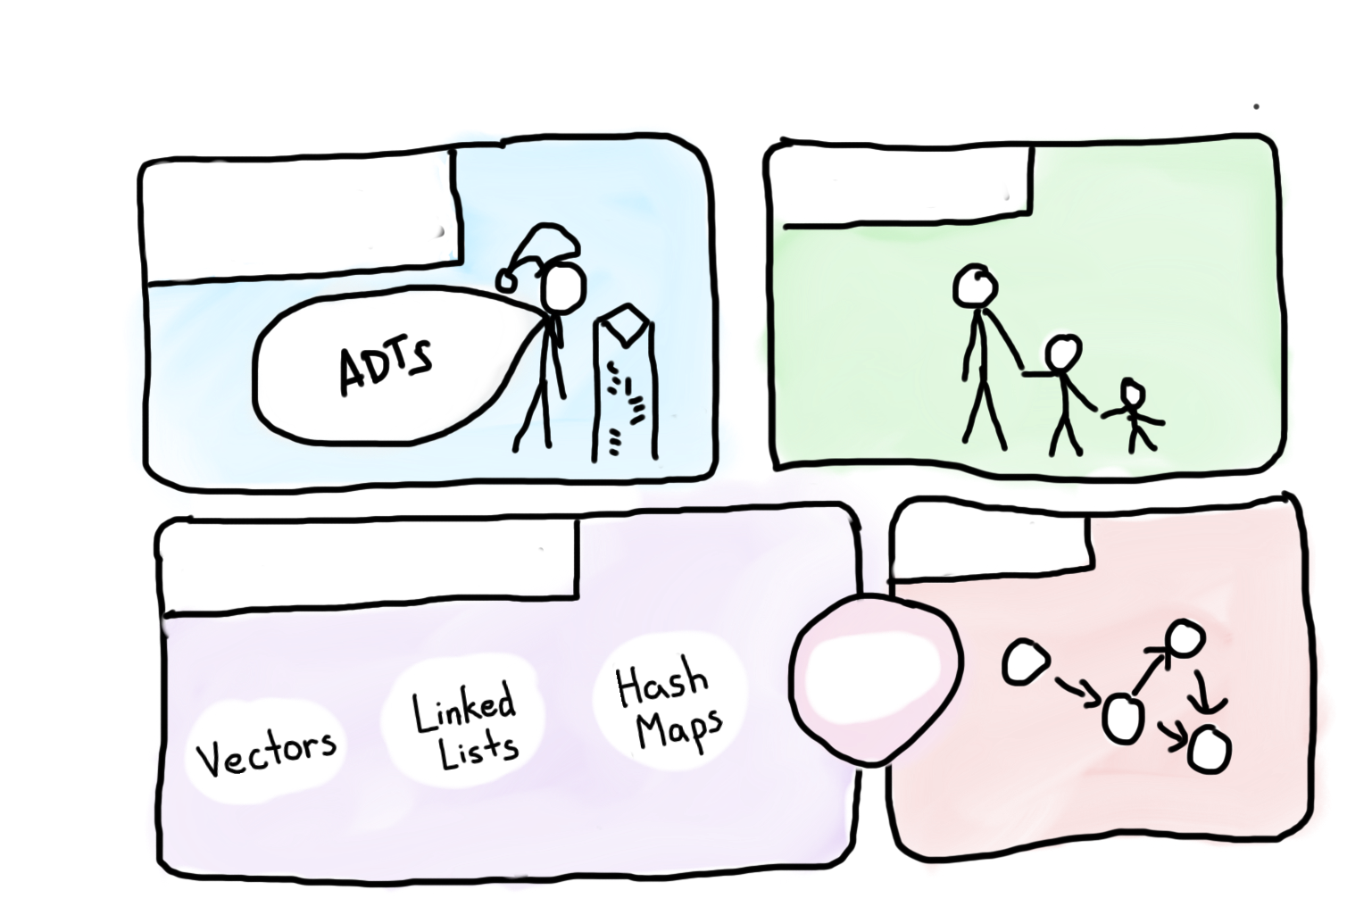

Course Syllabus
Intro to Abstractions
Recursion
Graphs
Under the Hood
Trees
You are here

Slide 13

Today’s Goals
You are ready for Assn 2

Slide 14
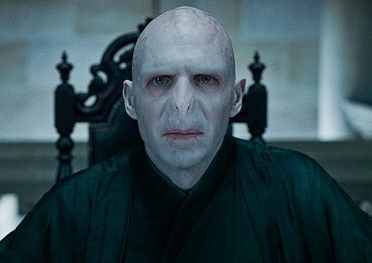
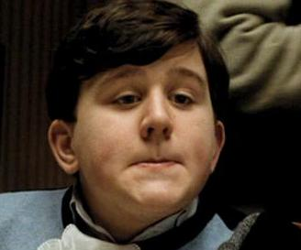

Interesting Puzzle
Counterfeiter
User
You (Distributor)

Slide 15
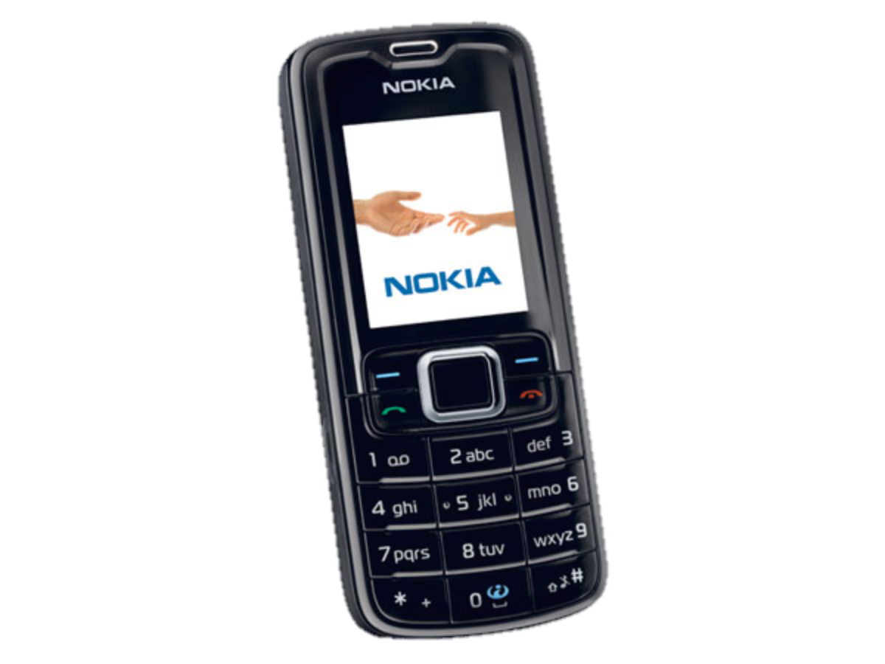
Interesting Puzzle
Counterfeiter
?
User
You (Distributor)

Slide 16

Fake Medicine is a Problem
700,000 deaths a year from fake malaria and tuberculosis drugs [1]
Equivalent of this many crashes per day
[1] http://www.un.org/africarenewal/magazine/may-2013/counterfeit-drugs-raise-africa%E2%80%99s-temperature

Slide 17
Interesting Puzzle
Counterfeiter
?
User
You (Distributor)

Slide 18
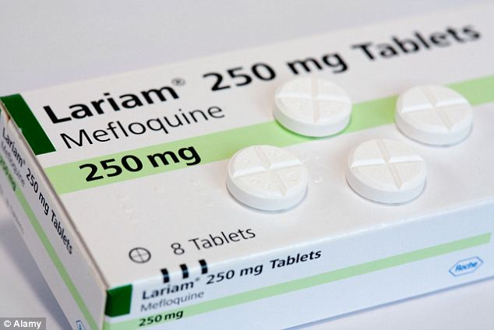
Real Life Challenge
Counterfeiter
?
User
You (Distributor)

Slide 19
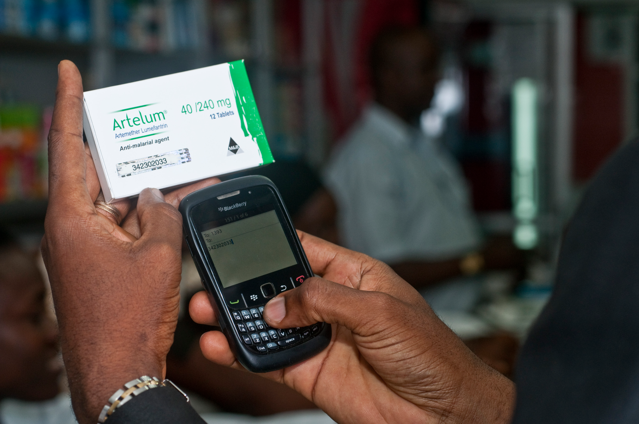
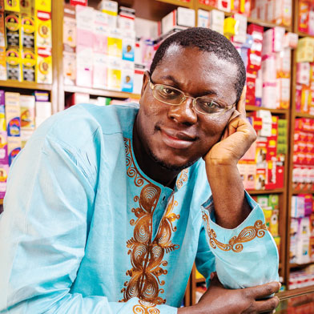
M Pedigree
Bright Simons

Slide 20
Mpedigree Datastructure (aka ADT)

Slide 21
What Datastructure
A. Vector<int>
B. Set<int>
C. Map<int, string>
D. Stack<int>

Slide 22

Solution

Slide 23
Collections
Vector
Grid
Map
Stack
Queue
Set

Slide 24

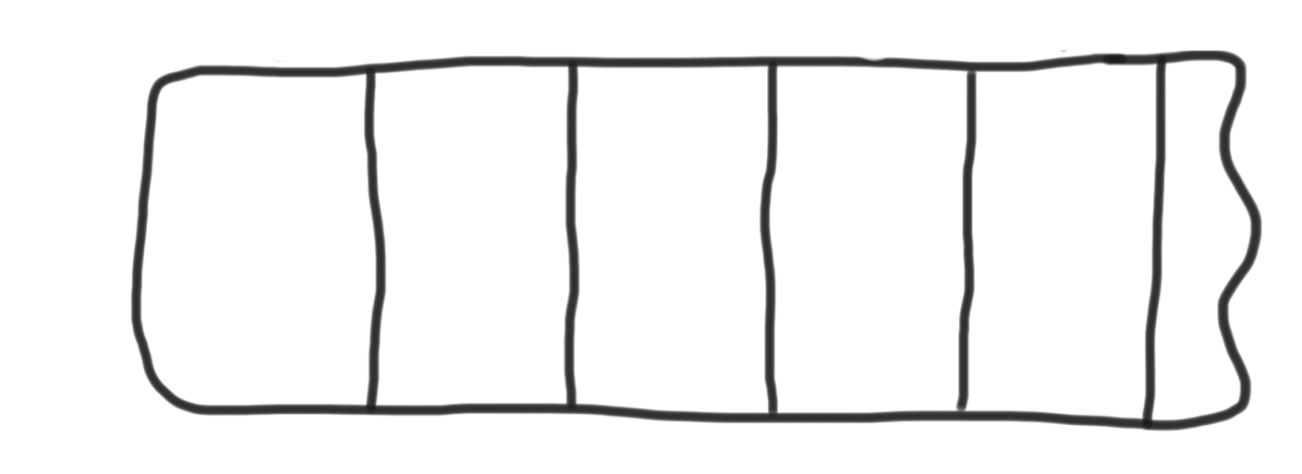
Vectors
Can grow to any size you need.
Supports random access.
0
1
2
3
4
8
15
16

Slide 25
Stack
Last in, First Out (so rude)
Slightly faster than vector.
Great style.
N
A
D
push
pop

Slide 26
Queue
First in, First Out (very fair)
Slightly faster than vector.
Great style.
N
D
A
enqueue
dequeue

Slide 27
Sets
Stores unique elements.
Put, contains and get are all incredibly fast.
No random access.
"the"
"of"
"if"
set.contains("to")
"to"
"down"
"from"
true
"by"
"she"
set.contains("be")
"you"
false
"in"
"why"
"him"
set

Slide 28
Maps
Stores key value pairs.
Put, contains and get are all incredibly fast.
Can get values using keys
"Chris"
"867-5309"
"Jenny"
"685-9138"
"Mehran"
"866-6586"

Slide 29
Lexicon
Like a set for words.
Convenient methods.
Can check if prefix exists.
”Car"
”House"
“Melifluous"

Slide 30
Collections
Vector
Grid
Map
Stack
Queue
Set

Slide 31
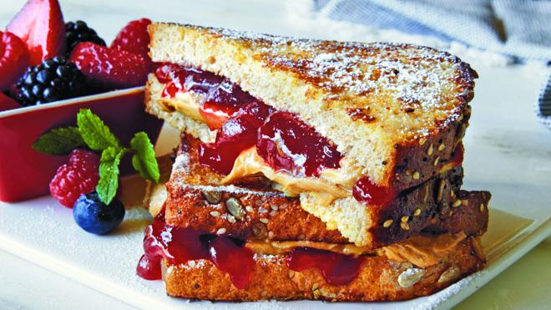
Sets, good
Maps, good
Sets + Maps, good

Slide 32
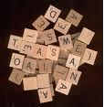
Anagram Exercise
Write a program to find all anagrams of a word the user types.
Type a word [Enter to quit]: scared
Anagrams of scared:
cadres
cedars
sacred
scared
What is the appropriate collection to use to solve this problem?
Hint: Use a compound collection...

Slide 33
Anagram Exercise
acders
{sacred, cadres,
scared, cedars}
deerssst
{stressed,
desserts}

Slide 34
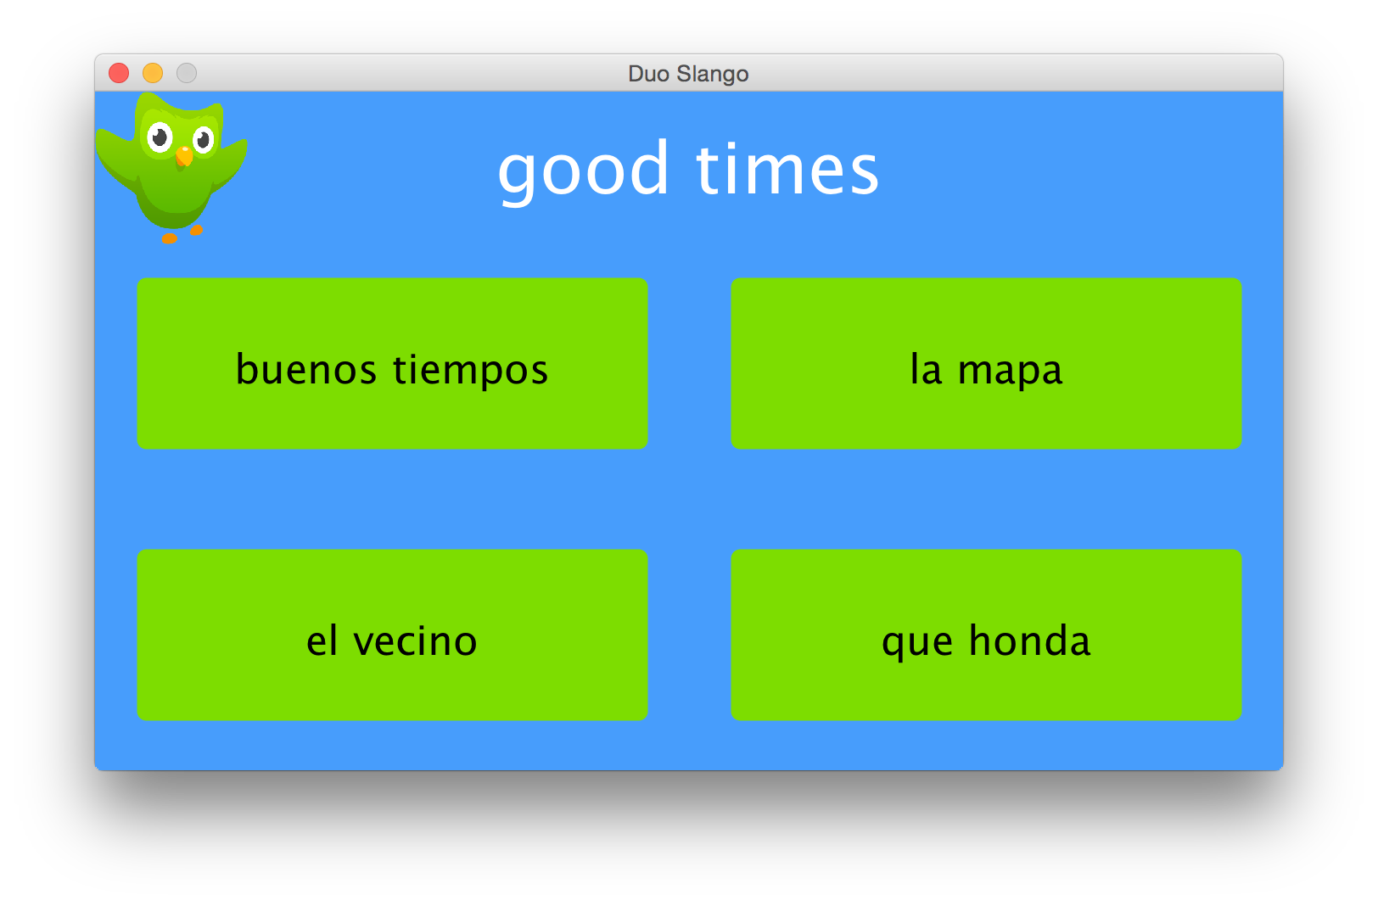
Another Cool New Program
Good, solid review and a new great idea.

Slide 35
Solution

Slide 36
Waypoints for your Spaceship?

Slide 37
Google Search?

Slide 38
Store the classes that all students in Stanford are taking?

Slide 39
The Value of All Variables
in a C++ Program?

Slide 40
Facebook Newsfeed?

Slide 41
Today’s Goals
You are ready for Assn 2

Slide 42

A Little Bit of Slope
John Ousterhout

Slide 43
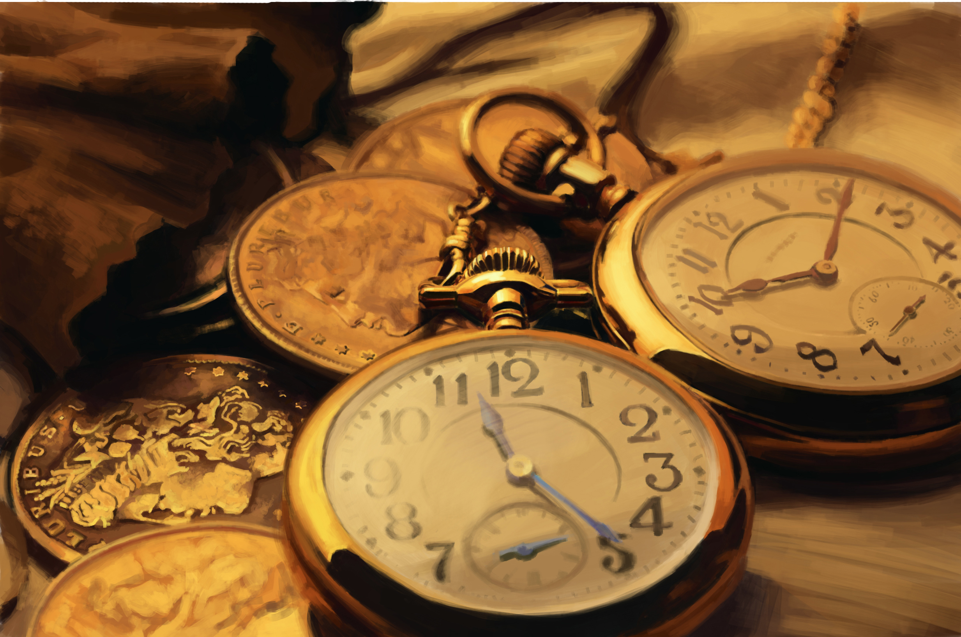
Thanks for the Time

